Slide 1
MY Bank Banking Application
Team : Asset Avengers
Module :Loan Application

Slide 2
Loans module allows users to view all the available loans in the bank
It also allows the users to apply for loans.
As well as search particular loans by loanType.
It also allows user to calculate EMI.
And provide a user- friendly responsive user interface.
Overview

Slide 3
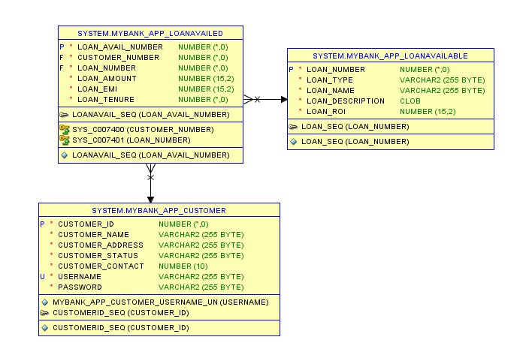
Database Design

Slide 4
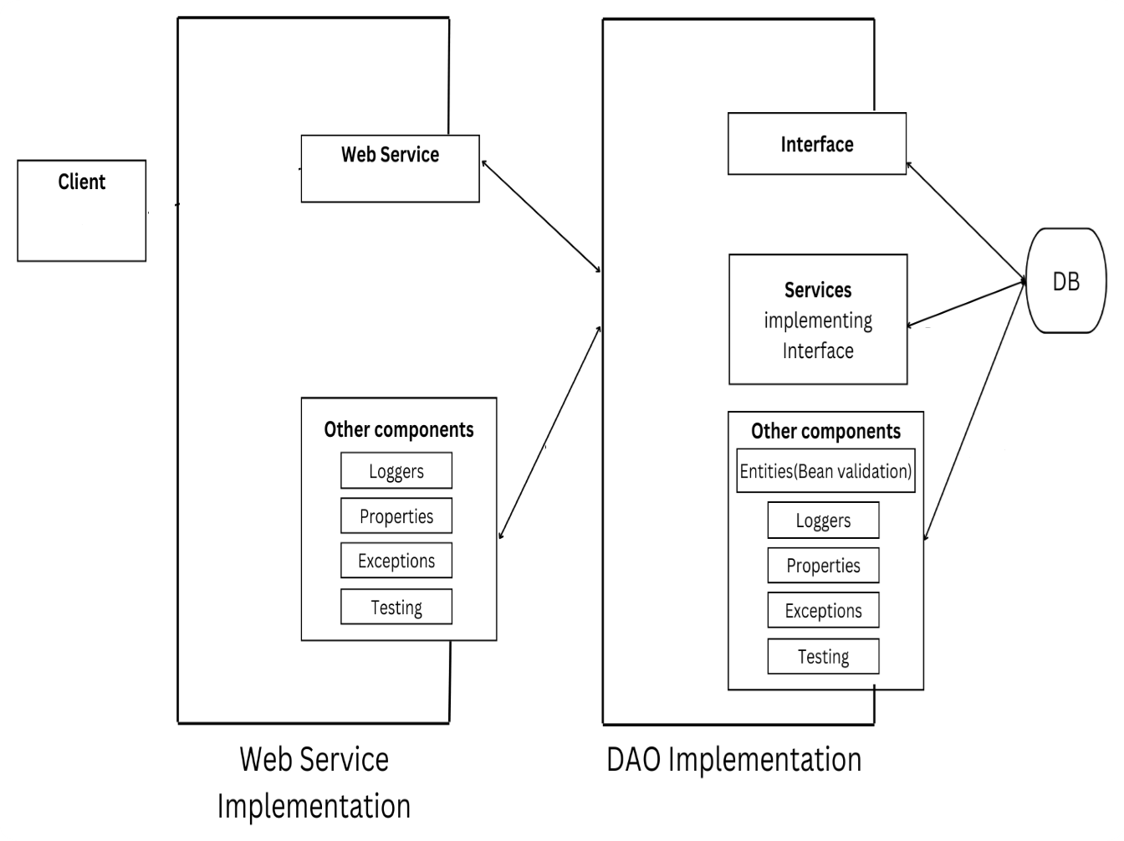
Project Structure
Frontend

Slide 5
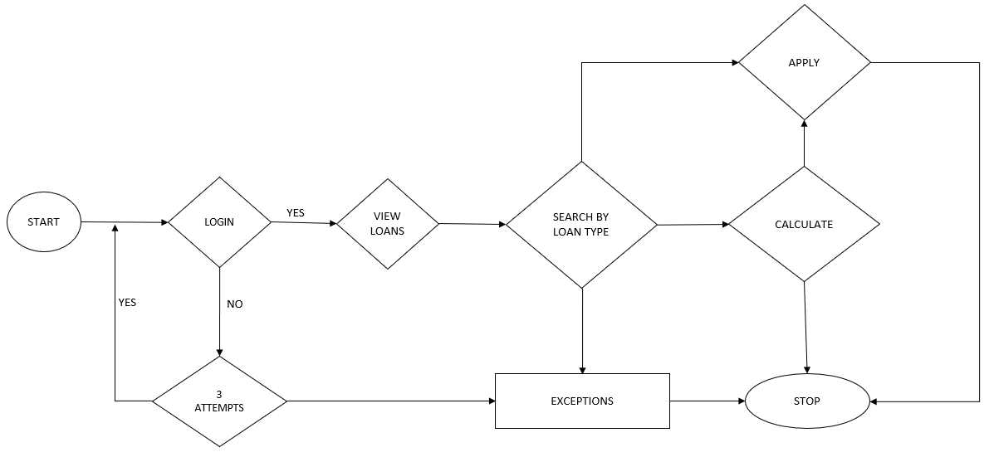
Data Flow Diagram

Slide 6
Thankyou

